Slide 1

Protect America Product and Services Overview

Slide 2
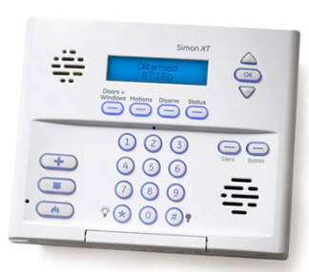
Introduction
Protect America is constantly researching and developing new and innovative ways to keep burglars at bay. One of the first ways is the Self – Install Simon Security System. With wireless equipment and a user friendly Interactive platform it allows our customers to be involved and take a pro active approach to the protection of their home and family.
During this course we will cover the following topics:
Alarm Statistics
System Components
Installation/Placement Suggestions
Monitoring Stations
False Alarm Prevention
*It is very important that we understand the basic fundamentals of an alarm system.

Slide 3
Burglary Statistics
In 2010, there were an estimated 2,159,878 burglaries—a decrease of 2.0 percent when compared with 2009 data.
Burglaries increased 2.0 percent in 2010 compared to the 2001 estimate.
Burglary accounted for 23.8 percent of the estimated number of property crimes committed in 2010.
Of all burglaries, 60.5 percent involved forcible entry, 33.2 percent were unlawful entries (without force), and the remainder were forcible entry attempts.
Victims of burglary offenses suffered an estimated $4.6 billion in lost property in 2010; overall, the average dollar loss per burglary offense was $2,119.
Burglaries of residential properties accounted for 73.9 percent of all burglary offenses
*Data found on the FBI website – Uniform Crime Report 2010
Forcible
Entry
Burglaries

Slide 4
Burglary Facts
The most common point of entry to a home was the front door, most often opened with a pry bar. The most common method of entry to a business was also prying a window or door.
Only 7.8% of the total value stolen from residences was recovered. 14.8% of the total value stolen was recovered from burglaries of businesses.
The average value stolen from homes was $1,517. The average value stolen from businesses was $1,890.
In 13% of residential break-ins, a burglar encounters someone at home. One-third of those encounters leads to assault and one in ten leads to rape.
Homes without security systems are about 3 times more likely to be broken into than homes with security systems.
*Sources: (Bureau of Justice Statistics & Temple University Study)
The ten most commonly stolen items:
Bicycles
Cameras
Drugs
Furs
Gold
Audio/video tapes and CD’s
Personal computers (including laptops)
Tools
Toys

Slide 5
The Mind of a Burglar
Recent survey of 248 convicted burglars: 45 surveys were completed
• Most of the respondents had burglarized a dozen or more homes.
• 27% of them had to break into more than 40 homes before being convicted and incarcerated in the prison system.
• The majority of burglars, 51%, like to work from midnight to 6 in the morning.
• Burglars do not like to risk breaking into occupied homes.
• 69% say they are attracted to a building if it looks like nobody is there.
• 33% say they picked targets because somebody told them the home or business would be empty.
• Simply locking the house or office does not work, according to the respondents. 84% said they break into locked houses or businesses.
• Only 13% said "lots of locks" would prevent them from entering a home or business.
• Even though police consider burglary a passive, non-violent crime, 44% of our respondents stated they carry weapons while out on the job (80% of these weapons
are guns).
• Why do these men and women commit this crime? 49% said the #1 reason they burglarize is to get money for drugs.

Slide 6
Where Burglars Enter a House
A survey conducted by Temple University shows some interesting statistics as to where burglars actually enter the premise:
81% of residential burglaries occur through
the first floor.
34% through the front door.
23% through a first-floor window.
22% through the back door.
9% through the garage.
4% through a basement.
4% through an unlocked entrance.
2% through a storage area.
2% through the second floor.
*A study conducted in Connecticut showed that 12% of burglaries occurred through an unlocked door and in 41% of burglaries where there was an alarm system, the system was not turned on

Slide 7
Burglar Alarms
A burglar alarm is a collection of sensors that connect to a control unit, either by wires or wirelessly. The system is a means to detect unauthorized intrusion and announces the alarm to elicit some type of response.
Where are Alarms Used
Residential
Home
Multi Family/Apartments
Condos
OR
Commercial
Businesses
Retail
Industrial

Slide 8
Why are Alarm Systems so Important
They serve to help provide:
As a deterrent against burglaries, vandalism and robberies.
Protection from bodily harm, property loss, etc.
Reduced Liability by properly alerting.
Peace of Mind, whether the customer is there or not.

Slide 9
Alarm Objectives
Security systems save lives and help provide protection for property. They provide us with a sense of security and assist us in the event of an actual emergency. Below is a list of the four most common objectives of an alarm system.
Burglar Deterrent - Did you know that statistics show that you are 3 to 4 times less likely to have a burglar try to break into your home if you place a security system sign on your front lawn and stickers in your windows? Burglars don't like alarm systems because they provide too much risk of being caught, so most burglar will move on to a home without a system.
Reducing Loss - When you have a security system, it will work to deter burglars from entering your home, which means that it is also minimizing your chances of losing your possessions. Losing your things can be traumatic and expensive. The alarm system will sound if an intruder tries to get in and most times will scare them off. If it doesn't then help will be on the way immediately which means that they won't have much time to take hardly anything.
Prevent a Confrontation - No one wants to come home only to be confronted by a burglar. By having an alarm system, the alarm will sound if an intruder breaks in, so if you come home and the alarm is sounding, you know not to go into your home. This is the best way to avoid a confrontation with a burglar, which can be traumatic for anyone.
Fire Detection - Most of the alarms these days have a way that you can hook up your smoke alarms to them. That way if a fire is detected, the alarm will sound alerting you to the danger. It will also alert the security company to the danger so they can call for help for you. This could save your family's lives.

Slide 10
Detection vs. Protection
Often times the words detection and protection are used interchangeably; however, it is important to remember that they have very different meanings.
Detection: the perception that something has occurred or some state exists
Protection:
1. The act of protecting or the condition of being protected
2. Something that protects
Alarm systems can not prevent things from happening;
they can only sense what has happened.
Alarm systems report an event that requires a response.
Alarm systems do not guarantee a proper or timely response

Slide 11
The Basic Functions of an Alarm
Burglar alarm systems are designed to detect events that may occur during an illegal entry, burglary, or other related events. Burglar alarms divided into two major groups:
Perimeter
Interior
They also have two sub groups:
Hold-Up/Duress
Environmental Condition

Slide 12
The Perimeter
What is the perimeter:
The perimeter of the house or building can be defined as the outermost reaches of an alarm system, such as:
Floors
Walls
Ceilings
Fences

Slide 13
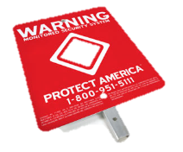
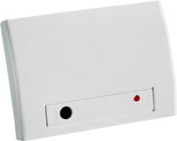
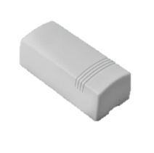
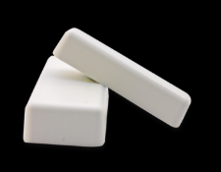
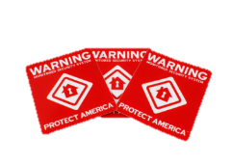
Perimeter Protection
Here at Protect America Inc. we have a variety of sensors designed to help the home owner detect against perimeter intrusion, these include:
Yard Sign & Window Decals
Door/Window Sensors
Overhead Door Sensors
Glass Break Sensors

Slide 14
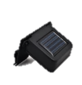
Yard Sign & Window Decals
The most effective piece of equipment we provide.
One yard sign & 3 window decals are included with every solution.
FBI Statistics show that homes with a monitored home security provider’s yard sign reduce their chances of being a victim of a burglary from 1 in 4 to 1 in 60.
Every yard sign includes a solar light to keep the sign illuminated at night.

Slide 15
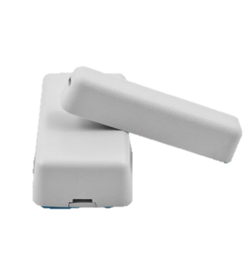
Micro Sensors for Doors & Windows
Can be placed on anything that opens.
Lithium watch battery lasts 3-5 years (CR2032).
The sensor trips when magnets in each piece are more than ¾ inches apart.
Recommended on all doors that lead in and out of home.
Can be placed on non-alarmed doors to alert the homeowner, but not the police:
For example: safes, gun safes, liquor cabinets, medicine cabinets, etc.

Slide 16
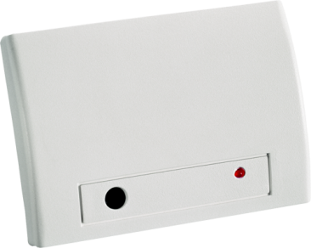
Glass Break Detector
Pattern Recognition Technology™ prevents false alarms by listening for the sound of hitting glass followed by breaking glass.
Ignores Most False Alarm Sounds
360° Coverage
Effective range of 20 feet from the detector.
Can mount on wall opposite windows or ceiling using tape or screws.
Reduced effectiveness by curtains, blinds and shutters.
Great for rooms with three or more windows or fixed windows that do not open.
Lithium “camera” batteries (CR123A) last 5-7 years.

Slide 17
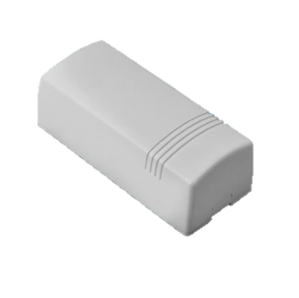
Overhead Garage Door Sensor
Mounts on a garage roll up door
Coin cell battery
Mechanical “tilt” switch detects when a garage opens.
Triggers at a 45º angle.
Built-in Tamper Switch
Recommended to have alternative method of disarming such as Keychain Remote, SmartConnect, or Mini Pinpad.

Slide 18
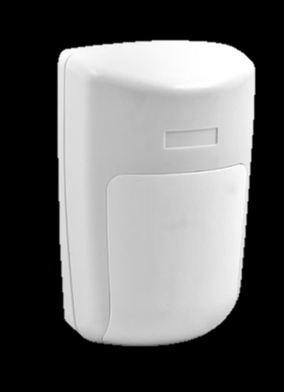
The Interior
The interior of the house or building is the inner most part of the perimeter. It is very important that the customer has interior protection (if possible). Protect America provides interior protection in the form of:
Passive Infrared (PIR) Motion Detectors

Slide 19
Motion Detector for Interior Protection
Effective range of 25 feet out & at a 90º angle.
Infrared technology detects both body heat and movement.
Pet friendly up to 40lbs.
Lithium battery lasts up to 6-8 years (CR123A).
Place over 6 1/2 to 7 feet up in a corner of a high-traffic, wide-open space.

Slide 20
Life Safety & Environmental Monitoring
Here at Protect America, we pride ourselves in providing our customers the most affordable home security. We also believe that protecting our families doesn’t just stop at securing doors and windows. Protect America offers Life Safety and Environmental protection as well in the form of:
Smoke/Heat Detectors
Carbon Monoxide Detectors
Flood Detectors
Freeze Detectors

Slide 21
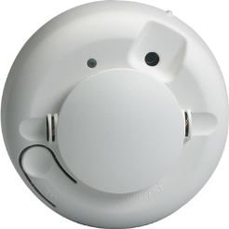
Life Safety Protection – Smoke/Heat
Uses Photoelectric Technology which is more effective at detecting most residential home fires than the more common ionization technology.
Built-in heat sensor detects rapidly rising temperatures or sustained high temperatures.
Many Homeowner’s Insurance policies or carriers may qualify for extra discounts with monitored smoke detectors.
Built-in Sounder
Field Replaceable Optical Chamber
Clean-Me Feature
Base Tamper
2 - 3 VDC Lithium Batteries

Slide 22
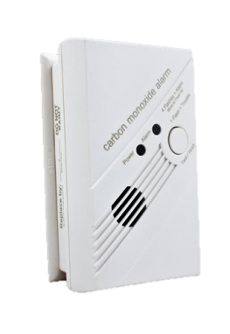
Life Safety Protection - Carbon Monoxide Detector
Detects unsafe levels of Carbon Monoxide (CO) and notifies monitoring facility.
CO is an odorless, colorless, tasteless gas that inflicts flu-like symptoms on its victims.
Advanced technology provides 7 year sensor life and 5 year battery life (3x AA alkaline batteries).
Battery power keeps device working even in power outage.
Install low to ground near bedrooms.
Built in piezo sounder
Built in tamper switch
Green LED for normal conditions
Red LED for alarm conditions

Slide 23
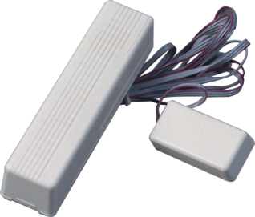
Environmental Protection – Flood Detector
Notifies homeowner when a flood occurs, even when they are away.
Best to install in an area that would be prone to flooding.
Water pipes
Under Sinks
Behind Toilets
Air Conditioner Drip Pans
Near Water Heaters
Near Washing Machines
2x AAA alkaline batteries last up to 2-3 years.
Non-alarm sensor notifies the homeowner, but not the police.
Ideal for vacation or seasonal homes that may be vacant for long periods of time.

Slide 24
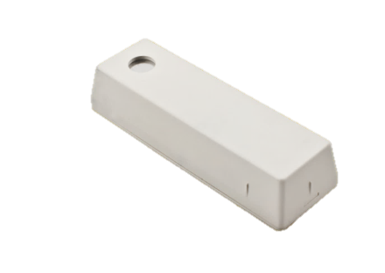
Environmental Protection – Freeze Detector
Monitors an Open Area of 900 sq. ft.
Detects when temperatures fall below a specified point (45º F) and Reset at 55-60° F
Non-alarm sensor notifies the homeowner, but not the police.
Make arrangements to get the furnace back up and running before water pipes freeze and burst.
Install in locations that will get cold quickly (e.g. entryway or laundry room).
Avoid installing in areas with excessive heat (e.g. near a furnace or heating vent).
3-5 year battery life on 1 3.6v alkaline battery.

Slide 25
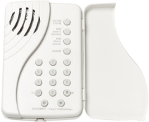
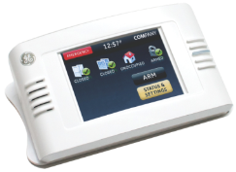
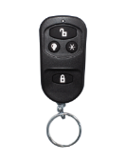
Keypads, Keychains & Panics
Protect America offers our customer protection against emergency threats. The way the system is designed allows the alarm user to report an emergency, such as a robbery or an ambush, while still following the intruders instructions. In addition, Medical services are available, allowing the user to notify the monitoring station that medical assistance is needed. The good thing about our services are that they are concealed in arming and disarming stations and are available 24 hours a day, they are as follows:
Two way talking touch pad
Touch Screen Touchpad
Keychain Remotes
Panic Pendant Button
Panic Pendant Wrist

Slide 26
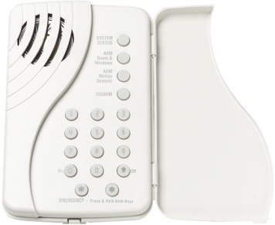
Keypads– Wireless Talking Touchpad
Easy wall mounting near most common entry point (e.g. garage door).
Arming the entire system (doors, windows, and motion sensors)
Arm the system with the No Entry Delay Function activated.
Disarming the system.
Triggering a panic alarm to signal the central monitoring station in the case of a non-medical emergency.
Check the entire system's status
Allows you to listen in to the voice feedback which is heard at the Simon XT Control Panel.
Does Not Chime
3 AAA Batteries

Slide 27
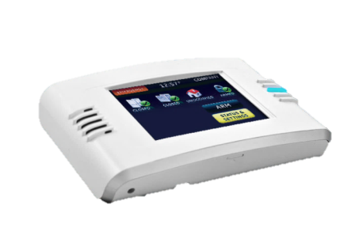
Keypads – Touch Screen Touchpad
3.5-inch color LCD screen with Graphical User Interface (GUI) delivers easy-to-understand information at a quick glance
Wireless design facilitates quick and easy installation
Simon XT compatible for added control of security system features
Does need AC Power
4 AAA batteries (for backup purposes only)
Arm the system (doors, windows, and motion sensors) Disarm the system
Activate a panic alarm to call the central monitoring station in a non-medical emergency
Check system status
Turn system controlled lights on or off (depending on your system configuration)
Hear voice feedback of the status of the Simon XT control panel

Slide 28
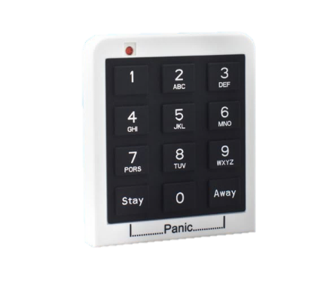
Keypads - The Mini Pinpad
Can be mounted virtually anywhere due to small size and no power cord.
Weather resistant makes it great for garages or car visors.
One button arming in both away or stay modes.
Hold arm & disarm buttons for Panic emergency alarm.
4 digit PIN required for secure disarming (no multi-user codes or Hostage code).
Lithium “watch” battery lasts 4-6 years (CR2032).

Slide 29
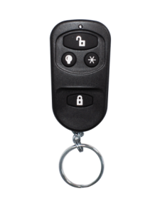
Keychains – Keychain Remote
One button arming & disarming.
Lock once for Stay Mode
Lock twice for Away Mode
Lock third time to activate the Latch Key feature (Landline Control Panels Only)
Hold arm & disarm button for a Police Panic.
Light On & Off Control (does not support Zwave )
Works as you’re pulling into the driveway or while you’re in the yard. Up to 100 foot range.
LED blink for feedback.
Recessed buttons prevent accidental false alarms.
Battery lasts 4-6 years (A27 alkaline).

Slide 30
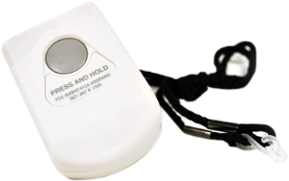
Panic – Panic Pendant
Panic button for emergency situations for around the home.
Easy to Push Button
Multiple ways to wear or mount include:
Nylon neck lanyard
Belt clip
Wall mounting bracket
Can be set to police, fire or medical emergency panic.
Water resistant allows to be worn in shower.
Effective range up to 100 feet from master panel

Slide 31
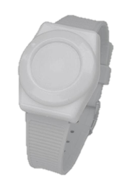
Panics - Panic Bracelet
Panic button for emergency situations for around the home.
Multiple ways to wear or mount include:
Velcro wrist strap
Nylon neck lanyard
Belt clip
Wall mounting bracket
Can be set to police, fire or medical emergency panic.
Water resistant allows to be worn in shower.
Effective range up to 100 feet from master panel

Slide 32
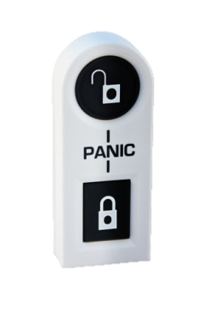
Panics – 2 Button Panic
Sleek modern look that fits in any room and in any hidden area
Wireless technology - Easier and less costly to install; safer because of flexible placement
Arms and disarms systems wirelessly, activates police or auxiliary panic alarm
Range - Functions at open-air distances of up to 150 ft.
Battery operated - Runs on lithium coin cell battery for five years (depending on amount of traffic)

Slide 33
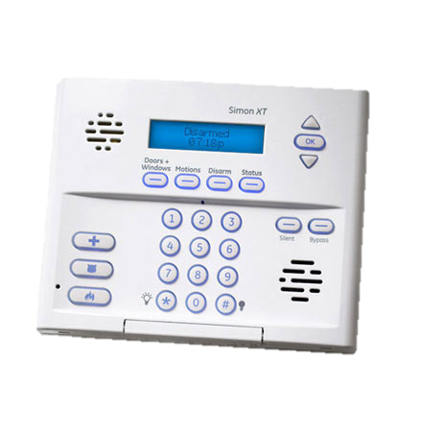
The Control Panel
The Control Panel is essentially the heart and brains of an alarm system. The control panel is responsible for receiving information detected by sensors.
When the control panel receives a signal from a sensor indicating an abnormal condition, it activates the siren and sends a notification signal to the monitoring station.

Slide 34
Simon XT: Master Control Panel
Up to 40 devices can be programmed in.
Designed to be placed on a countertop in a centrally located part of the home.
Programmable Chime Option:
Voice Chime:
“Front Door Open”
“Child’s Bedroom Window Open”
Soft Bell
Loud Bell
One-button Arming for “Stay” (Doors/Windows Only) or “Away” (Doors/Windows/Motions)
1 Master Code and 8 additional User Codes

Slide 35
Simon XT: Master Control Panel
Hostage code – Disarms system, but sends silent emergency signal to monitoring facility.
3 Emergency Panic Buttons
Medical – Soft Beeping
Police – Continuous Siren
Fire - 3 Pulse Temporal Siren
Loud interior siren to notify the intruder that they’ve been detected or everyone in the home when there’s an emergency.
Rechargeable Back-Up Battery lasts up to 24 hours in power failure.
“Turn off” sensors with Sensor Bypass button to leave a window open while the system is armed.

Slide 36
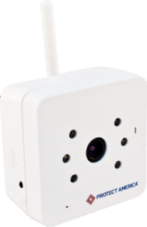
Video Camera Service
Interactive surveillance software on SMART Connect.
Video accessible from any internet-enabled device.
Built-in “night vision” allows for visibility in total darkness.
WiFi-enabled allows camera to be installed near any power outlet (12 foot power cord provided).
Watch what’s happening live with online video streaming.
Records 30 seconds of video when an alarm is tripped or the system is armed or disarmed.
Video at 30 frames per second (fps) & 720i resolution.
Effective visibility up to 20 feet & at a 60º angle.

Slide 37

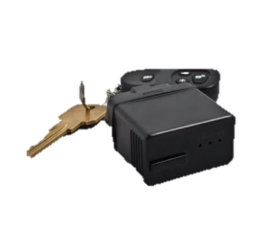

GPS Tracking Service
Pull up an interactive Google Map to see where a vehicle has been.
Sends an email notification when:
Vehicle is turned on or off.
Exceeds a specified speed.
Enters or exits a specified area.
The car battery is low.
Plugs into the Onboard Diagnostics (OBD) Port on the vehicle and operates off the car battery.
Most vehicles after 1996 have this port (except BMW & some other European vehicles).

Slide 38
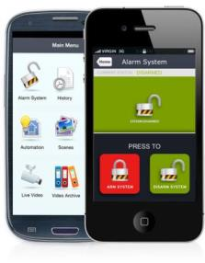
SMART Connect
Included FREE with Cellular or Broadband monitoring.
Not available on Takeovers or Standard monitoring.
Access the security system from any internet connection anywhere in the world.
Interactive app for Android or iOS devices.
View last 100 system events (e.g. which door opened, which code was used).
Arm (away or stay) or disarm the system.
Watch live video (PA camera service required).
Access Z-Wave devices (e.g. locks, thermostat, lights) as they become available.
Manage codes and alerts (email, text, or mobile device notifications).

Slide 39

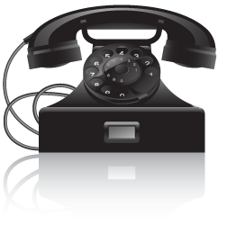
Monitoring Options - Standard
Most inexpensive monitoring service.

Remote Access from any Touch Tone phone.
Master Control Panel connects to phone outlet to communicate.
Not compatible with Voice Over Internet Phone
(VOIP) service (Vonage, MagicJack, Skype, Google Talk, etc.).
Not compatible with Digital Phone (phone does not plug into modem).
Not compatible with cellular or satellite phone services (Verizon Home Phone Connect).
Most insecure (burglar can cut the line).
Most homes do not have compatible service.
No SMART Connect.

Slide 40
Monitoring Options - Two-Way Voice
 Add on to Standard Monitoring.
 Like “On Star” for the home.
 Turns Simon XT Panel into a “speaker phone” to the monitoring facility.
 Hands-free communication in an emergency.
 No “Easter Egg” hunt for the telephone handset.
Ideal for homes with teens, elderly or anyone with medical conditions.

Slide 41

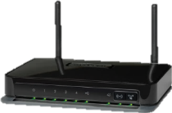
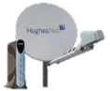
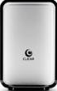
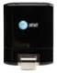
Monitoring Options - Broadband
Panel is plugged into internet connection through Ethernet port on router.
Always recommend an extra keypad.
Not compatible with Westel routers.
Not compatible with dial up.
Not compatible with cellular based internet (Clear Wireless, hot spot, etc.).
 Fastest connection – Instant message or email to monitoring facility!
 Most inexpensive solution if there is no phone line.
 FREE SMART Connect!
Common Issues:
Internet may drop – no communication.
Cannot communicate without power.
The following Internet Providers are not compatible:
Satellite Internet
Mobile Hotspot
Data Connect Cards

Slide 42

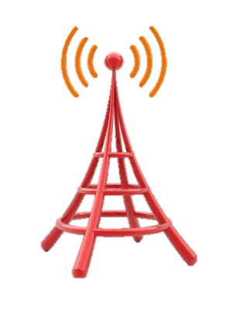
Monitoring Options - Cellular
Connects wirelessly to nearest GSM cell towers.
Not relevant to homeowner’s cellular service.
Available service in most areas!
AT&T must be full coverage.
Or T-Mobile must have full coverage.
Better than a cell phone.
Longer antenna.
Doesn’t move around the house.
More power than a cell phone battery.
FREE SMART Connect!
Most secure service – no line to cut, not likely to go out.
Most expensive monitoring service.

Slide 43

The Monitoring Station
Using a Monitored System, signals at the house or business are usually indicated at the alarm site but are also sent to a remote location called a monitoring station. Systems are usually designed to report alarm signals to central station operators for subsequent verification and request for dispatch.

Slide 44

What is a Monitoring Station
A monitoring station is a secure location dedicated to the receipt of alarm signals and the swift and precise reaction to those signals. Personnel (operators) are maintained continuously to record and investigate alarms, supervisory signals, and/or trouble signals received from connected signaling devices in a subscriber's premises.
Facilities are provided for the reporting of alarms to police and fire departments or to other outside agencies.
Watching a monitoring station, especially for the first time, can be exciting, confusing, and a little overwhelming. All the noise, lights and activity can be hard to sort out. There is a method to the madness, however, as you will soon see.

Slide 45
What is a Monitoring Station
The Monitoring Station serves as the primary point of contact for an alarm company's customers. Twenty-four hours a day, three hundred and sixty five days a year, signals from customers' systems are received and processed.
Round the clock monitoring station operators react to customer alarms, initiate a response to the problem(s), and alert the appropriate responding agencies, such as police, fire, medical, etc.

Slide 46
Primary Responsibilities of the Monitoring Station
The primary responsibility of the Monitoring Station to its customers is to pass along all signals to the proper authorities and/or customer representatives.
To do this properly, Monitoring Stations maintain information in computers, written files, or both. A great deal of information is kept for each account, including:
• The Name
• Address
• Phone Numbers
• Information about the system
• The appropriate action to be taken for every alarm and/or supervisory signal that can be transmitted.

Slide 47
Common Types of Signals
There are several types of systems sold as part of the services our industry offers. The installation company should indicate exactly what they expect the monitoring station to do if they receive any of the following signals.
There are four (4) general types of signals:
• Fire
• Hold-Up/Emergency
• Burglary
• Process or Condition

Slide 48
Other Common Signals
There are several different diagnostic signals found in alarm systems, including the following:
AC Power Failure
Communications Failure
Low Battery
Restore
Supervisory
Test
Fail to Test
Trouble
Open/Close
Cancel/Abort

Slide 49
False Alarms
What is a False Alarm?
Municipality Perspective:
False Alarms are alarms activated through means other than the criminal activities the alarms were designed to detect and report.

Slide 50
False Alarm vs. False Dispatch
A "false alarm" occurs when an alarm system sends a signal of intrusion (or fire) when no such condition exists.
A “false dispatch" occurs when responders (police, fire, etc.) are sent to the scene after receiving the false alarm signal.
False alarms occur all of the time. In 77% of the cases, the alarm industry, through various verification procedures, does NOT dispatch the authorities. It is the remaining 23% of the calls that become false dispatches.
To fix the problem, it is not enough to reduce false dispatches, we must also reduce false alarms, as they will eventually become false dispatches.

Slide 51
What Causes False Alarms – Reason 1 User Error
Most user errors occur during the Entry or Exit of a residence or building. Below are a few examples of these occurrences.
• User Arms - Exits - Re-enters
• User Arms - Fails to Exit in Time
• User Arms - Building is Still Occupied
• User Arms - Exits through Wrong Door
• User Arms - Fails to Exit at All!
• User Enters - Forgets Code
• User Enters - Fails to Disarm in Time
• User Enters - Unfamiliar with Systems
• User Enters - Through the Wrong Door
-Non-Delayed
-No Keypad - Unable to Hear Prewarn

Slide 52
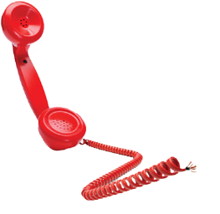
What Causes a False Alarm – Reason 2 Misapplication
The Second Most Common Problem is misapplication of technology. Because our technology is wireless, a lot of users think they can use the equipment any where. It is very important that the user know and understand the manufacturers specifications and use the equipment accordingly.

Slide 53
What Causes a False Alarm – Reason 3 Power Related
The Third most common problem is power related. Either the customer has the system powered incorrectly or the was a power surge of some kind. The batteries running low on sensors could also be potential for a false alarm.

Slide 54
What to do if a False Alarm Occurs
If a false alarm occurs and the customer knows for sure it was not an actual break in they can call us at 1-800-951-5111 Option 4 and request that the dispatch be canceled provided they can verify who they are by using the last 4 of their social or their verbal password.
Or
The customer can call the monitoring station directly at 1-877-274-0604. They will need to provide their verbal password in order to cancel dispatch.
If a representative is on the phone with the customer and a false alarm occurs. Immediately place the customer on hold and dial the monitoring station dealer services at 1-800-482-9800. The customer will need to provide a valid passcode.

Slide 55
Questions?

